Slide 1
Lecture 1-2
SOFTWARE ENGINEERING
Multi person construction of multi-version software
Zeeshan Ali Rana

Slide 2
Tentative Grade Distribution
Quizzes (Announced + Unannounced) – 10%
Assignments + Project + Class Exercises – 20%
Mid Term Exams – 30%
Final Exam – 40 %
Passing Criteria
Minimum Attendance Requirements Met
Minimum Marks Requirements Met

Slide 3
Text Books
Roger Pressman, Software Engineering: A Practitioner’s Approach(Selected Chapters)
Shari Lawrence PFleeger and Joanne M. Atlee, Software Engineering Theory and Practice, Fourth Edition (Selected Chapters)
Ian Sommerville, Software Engineering (Selected Chapters)

Slide 4
Course Information
Instructor: Dr. Zeeshan Ali Rana
Office: First floor new building (F Block)
Phone Extension: 562
Email: zeeshan.rana@nu.edu.pk
TA:
Office Hours:
Email: @lhr.nu.edu.pk

Slide 5
Software Engineering
Solving Problems
Computers
Computing

Slide 6
Software?
Computer programs along with associated configuration data and documentation s.t. the programs are correctly operated
Configuration data helps set up the programs
System documentation helps understand structure of the system
User documentation explains how to use the system

Slide 7
Engineering?
Engineers’ Job?
Make things work
Apply theories, methodologies, tools appropriately
Provide solutions in absence of applicable theories and methods
Realize financial and organizational constraints

Slide 8
Software Engineering
Solving problems that involve computing and computers?
Solving problems that involve computing and computers in a consistent/systematic manner?
A set of guidelines for solving the computing and computer related problems in a systematic manner?
Engineering software by remaining concerned about all aspects of software production?

Slide 9
Aspects of Software Production?
Size of the software system to be built
Complexity of the software system to be built
Need and involvement of teams
Technical process of developing software
Activities such as management of project and teams
Development of tools, theories, methods to support production of software

Slide 10
Software Engineers?
Adopt a systematic and organized approach, effectively, to produce high quality software
May have to use Ad hoc approaches to develop software
Some real complex problems may not be solved using elegant theories of CS
new algorithms?

Slide 11
Paradigm
Resources
Software Engineering
Process
Skillset
Lifecycle
Requirements Analysis | Design | Coding | Testing | Deployment | Maintenance
Typical phases in lifecycle of software

Slide 12
Software Lifecycle
Phases
Requirements analysis and definition
System (architecture) design
Program (detailed/procedural) design
Writing programs (coding/implementation)
Testing: unit, integration, system
System delivery (deployment)
Maintenance

Slide 13
Why is SE Needed?
Improve our living standard

Slide 14
Size of Software Industry: > USD 600 billion
(Gartner 2022)
Global IT Spending: USD 4.2 trillion
(Gartner 2022)
Forecast: ~ USD 1400 billion
(by 2030)

Slide 15
Challenges for Software Industry
 | 2012 | 2013 | 2014 | 2015 | 2016
Successful Projects | 27% | 31% | 28% | 29% | 32%
Challenged Projects | 56% | 50% | 55% | 52% | 49%
Failed Projects | 17% | 19% | 17% | 19% | 19%
Report for Year 2012 to 2016 (Standish 2016)

Slide 16
Challenges for Software Industry
Successful Software Projects ~ 33%
(Standish Group)
Factors Affecting Project Success Rate
Project Size and Complexity
Customer Satisfaction Level
Development and Budget Process
Skills of Developers and Managers
are
These factors are associated with defects. (Jones 2008)

Slide 17
Industry Challenges and Software Defects
Factors affecting Project Success Rate
Customer-Developer Communication Failure
Faulty Definition of Requirements
Documentation, Design, Coding Errors
may result in
cause
Project Success Rate
impact
Cost and Schedule
impact
Defects
Customer satisfaction level
indicate
Lower the defects, higher the software quality.
impacts
indicate
Software Quality
(Kan 2002, Galin 2004, Jones 2008)

Slide 18
Defects and Software Quality
Defect
Failure to meet requirements (or expectations) of user/customer (Kan 2002)
Software Quality
Fitness for Use (Juran and Gryna 1970)
Conformance to Requirements (Crosby 1979)
Freedom from Deficiencies (Juran 1988)
Lack of Defects (Kan 2002)
Removal of defects, increases quality, incurs cost.

Slide 19
Cost Associated with Defect Correction
Unit Cost to fix a defect
Defects prevention can reduce costs.
Requirements Analysis | Design | Coding | Testing and Deployment* | Operations
*Testing the system before delivery and at the time of delivery
(Khoshgoftaar et al. 1996 , Galin 2004)

Slide 20
Software and Defects?
Software vs Engine (wear-out???)
Software vs House
Software vs Cars (models? Versions?)
Stability????
Problems??? Defects???
Malleable
Human intensive

Slide 21
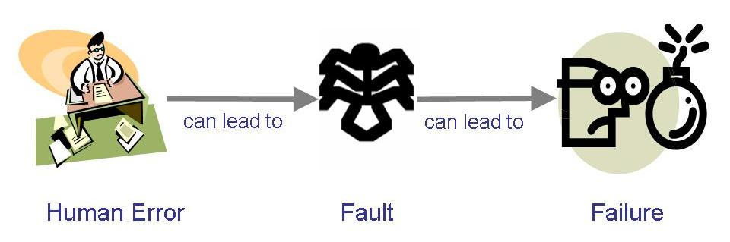
Terminology for Describing Bugs
A fault: occurs when a human makes a mistake, called an error, in performing some software activities
A failure: is a departure from the system’s required behaviour

Slide 22
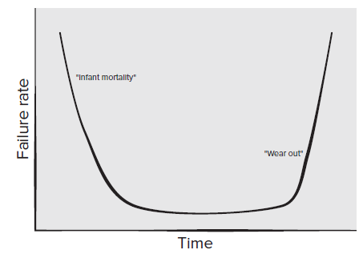
Failure Curve for H/W

Slide 23
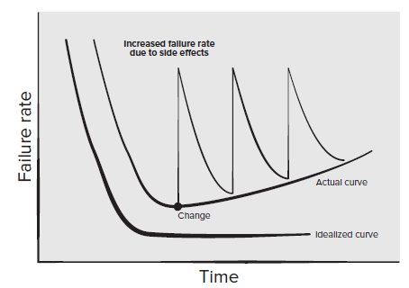
Failure Curve for S/W

Slide 24
Lehman’s Laws
(1974) "Continuing Change" — A system must be continually adapted or it becomes progressively less satisfactory. It happens so until it becomes economical to replace it by a new or a restructured version
(1974) "Increasing Complexity/Entropy" —Complexity/entropy of a system increases with time, unless work is done to maintain or reduce it
(1991) "Continuing Growth" — the functional content of a system must be continually increased to maintain user satisfaction over its lifetime
(1996) "Declining Quality" — the quality of a system will appear to be declining unless it is rigorously maintained and adapted to operational environment changes

Slide 25
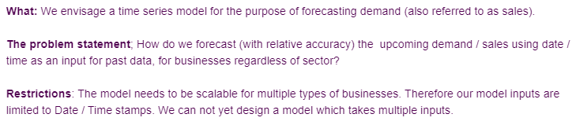
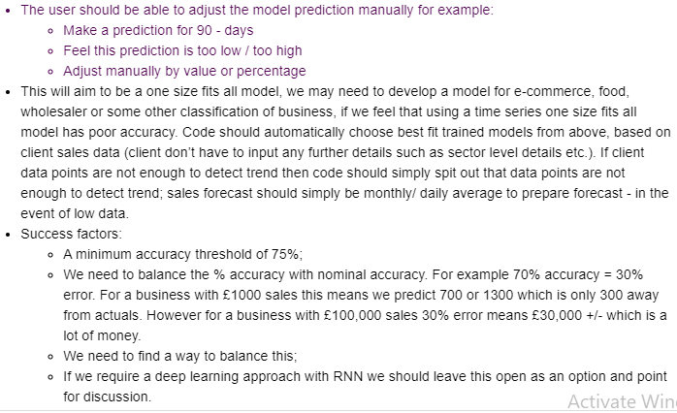
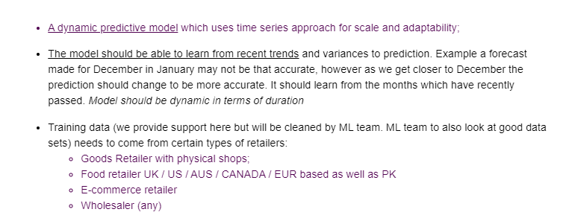
We need a time series model for the purpose of forecasting demand

Slide 26
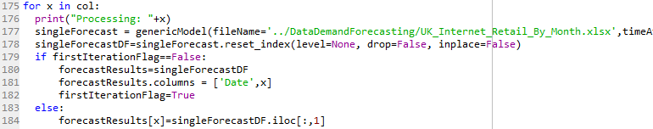
Examples
Write the forecast output in a file
Should be run once for multiple businesses

Slide 27
Costs in Software Engineering
Cost to change software
Cost to overcome a mistake (defect)
Cost of developing software
Operational cost
Deployment cost

Slide 28
Software Engineering
Disciplined, consistent, and systematic effort to construct (design + build) and maintain good quality software in timely and cost-effective manner

Slide 29
What is a Good Software Product?
Good software engineering must always include a strategy for producing quality software
Product Quality?
Multiple facets…

Slide 30
What is a Good Software Product?
Users judge external characteristics (e.g., correct functionality, number of failures, type of failures)
Designers and maintainers judge internal characteristics (e.g., ease of modification)
Thus different stakeholders may have different criteria
Need quality models

Slide 31
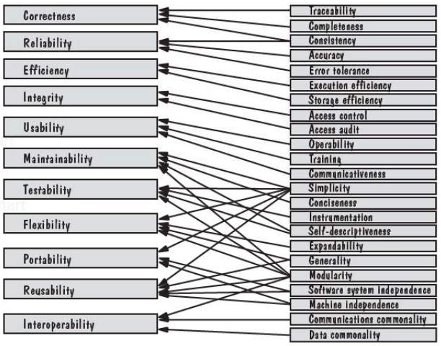
McCall’s Quality Model

Slide 32
Software Engineering Challenges
Acceptable Quality
Usability
Security
Reliability
Performance
Cost Effectiveness
Engineering and operational feasibility
Limited development budget
Timely Completion
Limited time
Conflicts?
Manage Conflicts…

Slide 33
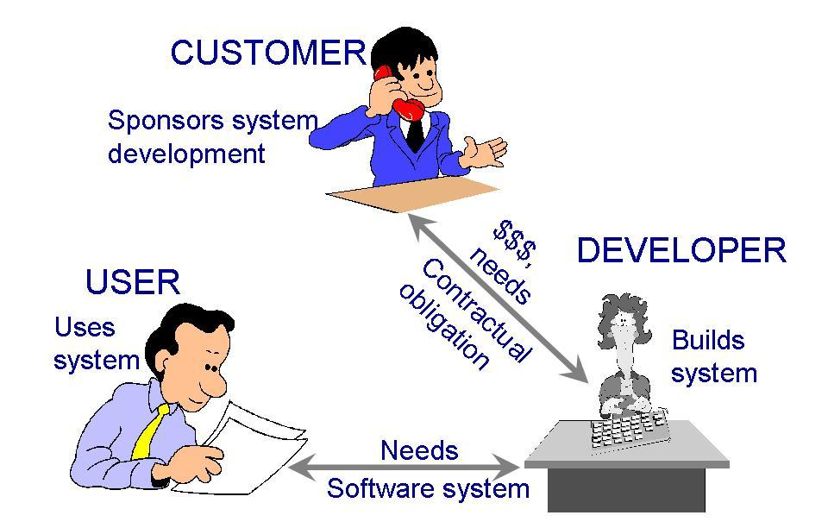
Who Does Software Engineering?
Participants (stakeholders) in a software development project

Slide 34
Development Team
Requirements analysts: work with the customers to identify and document the requirements
Designers: generate a system-level description of what the system is supposed to do
Programmers: write lines of code to implement the design
Testers: catch faults
Trainers: show users how to use the system
Maintenance team: fix faults that show up later
Librarians: prepare and store documents such as software requirements
Configuration management team: maintain correspondence among various artefacts

Slide 35
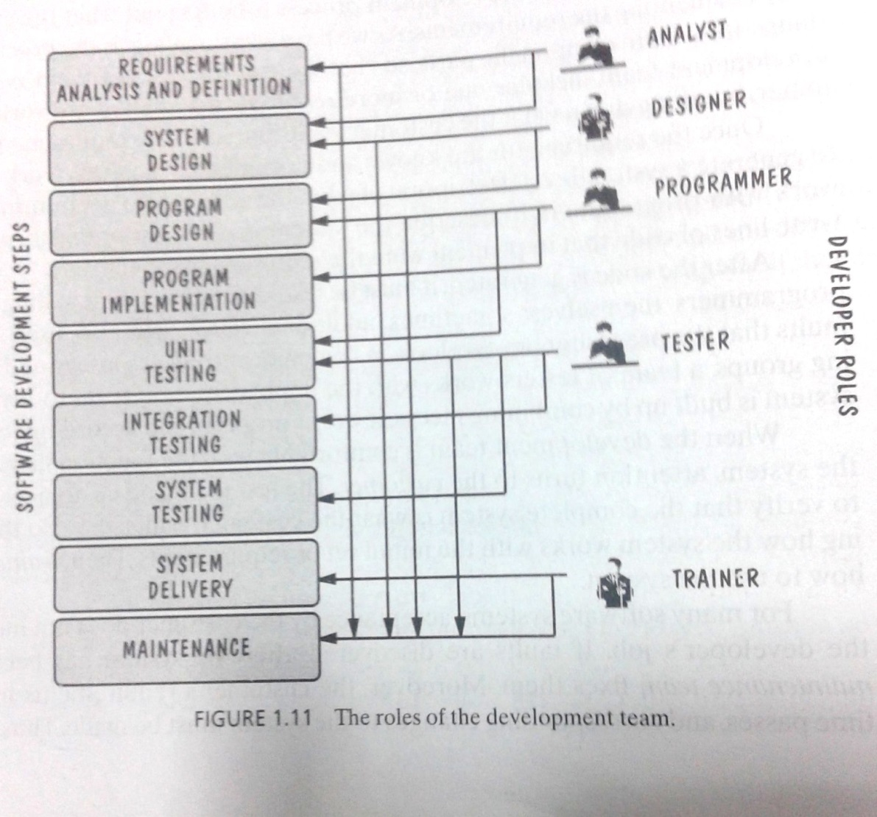
Development Team (Roles)
Who Does What?

Slide 36
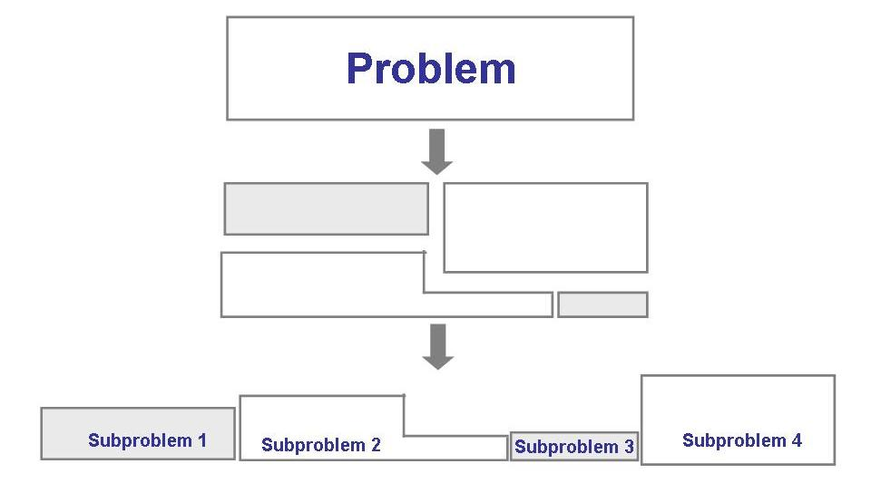
Solving Problems
Analysis

Slide 37
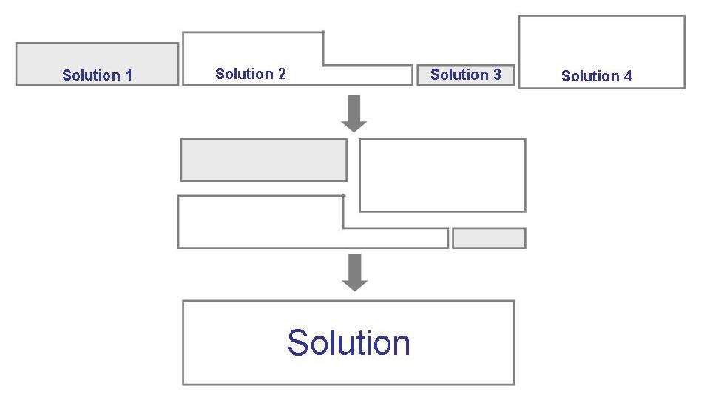
Solving Problems (continued)
Synthesis

Slide 38
How Successful Have We Been
Perform tasks more quickly and effectively
Word processing, spreadsheets, e-mail
Support advances in medicine, agriculture, transportation, multimedia education, and most other industries
Many good stories
However, software is not without problems (recall the Standish report on challenged and failed projects???)

Slide 39
How Successful Have We Been
IRS hired Sperry Corporation to build an automated federal income tax form processing system
An extra $90 M was needed to enhance the original $103 M product
IRS lost $40.2 M on interests and $22.3 M in overtime wages because refunds were not returned on time
Malfunctioning in Therac-25 killed several people
Reliability constraints have caused cancellation of many safety critical systems
Safety-critical: something whose failure poses a threat to life or health

Slide 40
Software Application Domains
Broad categories of software
System software: programs written to service other programs e.g. compiler, editor, operating system components
Application software: stand-alone programs to solve a specific business need e.g. Information systems like leave management system, point of sales system
Engineering/Scientific software: programs that can simulate things like astronomy, volcanology, molecular biology etc.

Slide 41
Software Application Domains
Broad categories of software (Contd.)
Embedded systems: resides within a product or system and performs special functions for user as well as for itself e.g. system to measure temperature in a control shed, keypad control in a microwave oven
Product-line software: software for a group of related products marketed under a single brand name e.g. MS Word, PowerPoint, Excel etc.
Web/Mobile applications: browser based and mobile device based apps
Artificial intelligence software: makes use of non-numerical algorithms to solve complex problems e.g. robotics software, expert systems to diagnose a disease, forecasting system

Slide 42
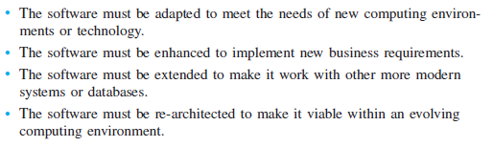
Legacy Software
Old systems
Difficult to change further

Slide 43
Software Engineering Principles
Some principles are:
Rigor and Formality
Precision and exactness
Assessment of engineering activity and the results
Separation of Concerns
Flow of data and flow of control
Correctness and efficiency
Parts of system
Modularity
Anticipation of Change

Slide 44
References
Shari Lawrence PFleeger and Joanne M. Atlee, Software Engineering Theory and Practice, Fourth Edition
Roger Pressman, Software Engineering: A Practitioner’s Approach
Ghezzi et al., Fundamentals of Software Engineering
Book slides from UCF
Acknowledgement
A few slides have been reused from UCF slides for the SE course

